Slide 1

Medical test recommendation system using the patient symptoms “GB-Medibot”
Group members:
1- Shoaib ud-din G1
2- liliyom G3
3-Ania shams G3

Slide 2
Problem statement:
We observe that individuals do not care about their health at all and do not have the patience to go through the process of meeting a doctor in hospitals i.e., reaching the hospital, making an appointment, waiting for hours .
We can be able to diagnose a disease by just entering a symptoms to our model

Slide 3
Steps we follow:
Here are the steps that we follow:
Data collection and creating Dataset.
Preprocess the Data.
Apply ML model and test its accuracy.
We use pre-trained model of Bert .
Fine-tune.
Testing
Developing to user interface

Slide 4
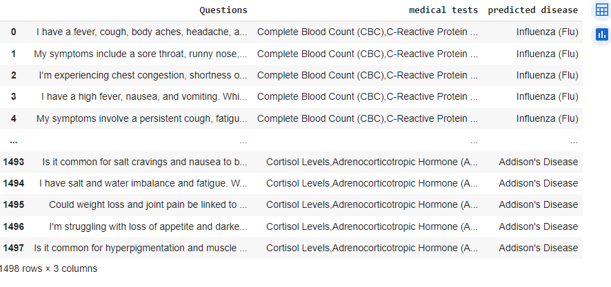
Dataset:

Slide 5
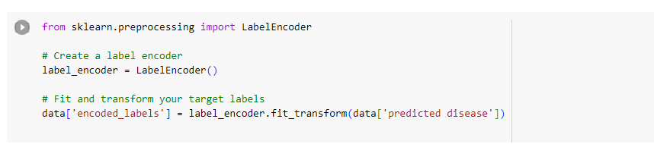
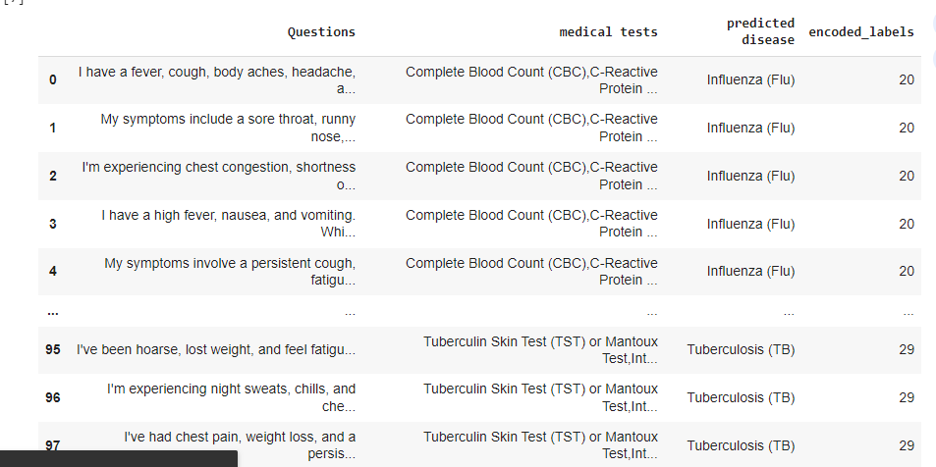
Label encoding:

Slide 6
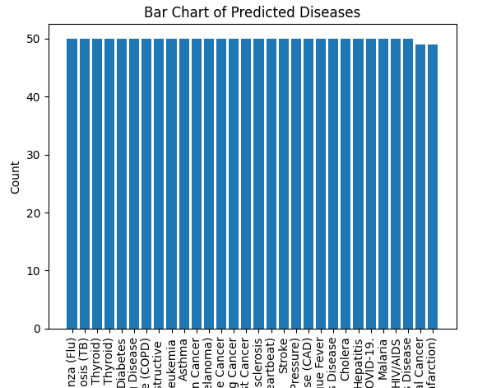
Dataset Overview and Exploratory Data Analysis (EDA):

Slide 7
Model Selection:
We select a Bert pre-trained model:
Bidirectional
Transformer Architecture
Pretraining and Fine-Tuning
Embeddings (768)

Slide 8
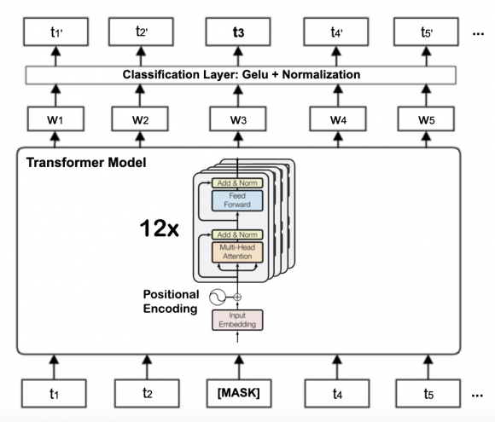
Model Architectures:

Slide 9
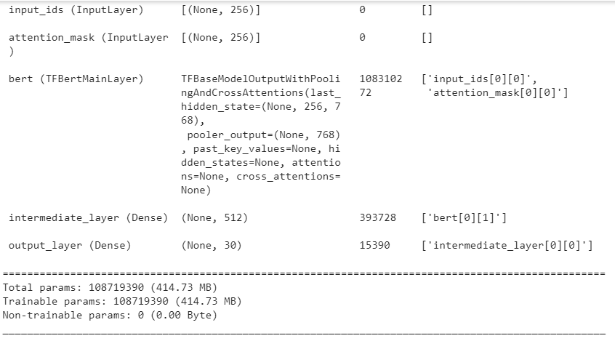
Model summary:

Slide 10
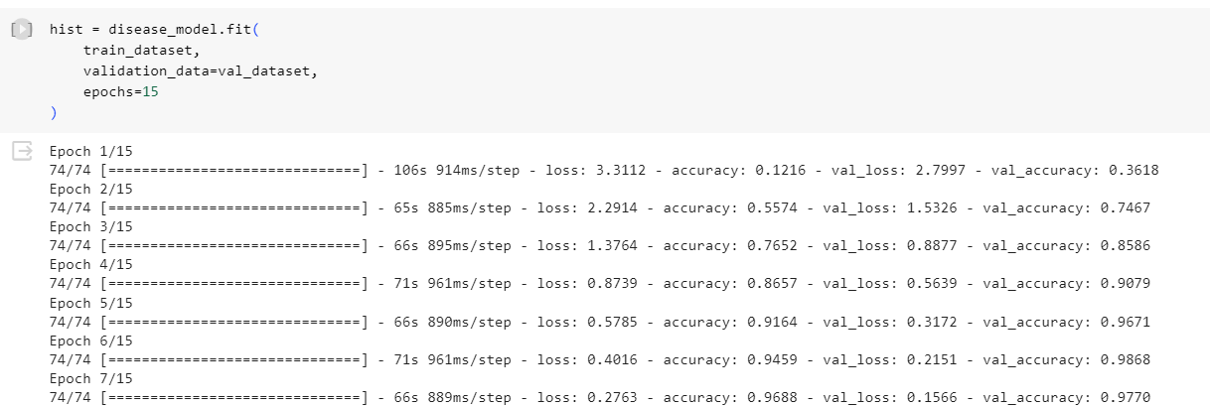
Model Training Process:

Slide 11
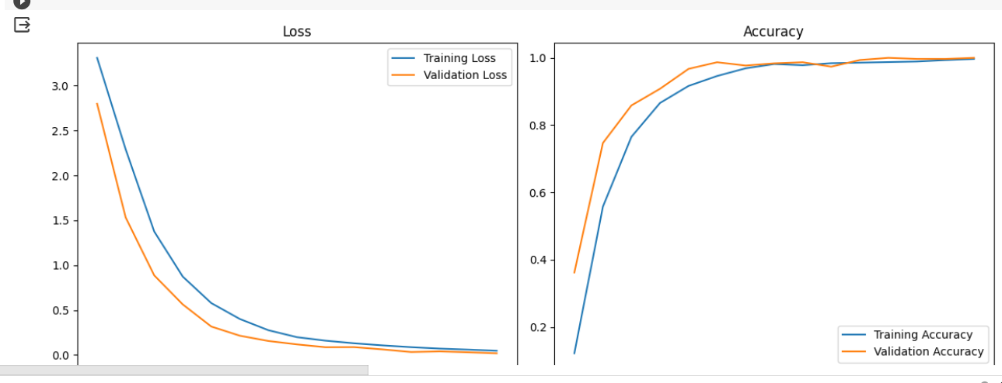
Evaluation Metrics and Results:

Slide 12
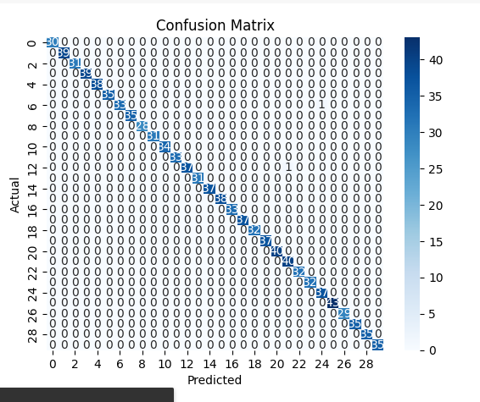
Confusion matrix:

Slide 13
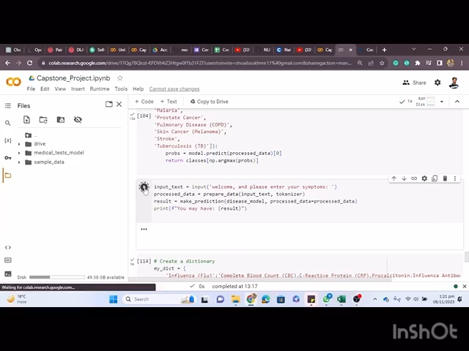
Demo:

Slide 14
Streamlit:
Streamlit can provide a user-friendly interface, building a chatbot still involves robust NLP and AI components to understand and respond to user input effectively.

Slide 15
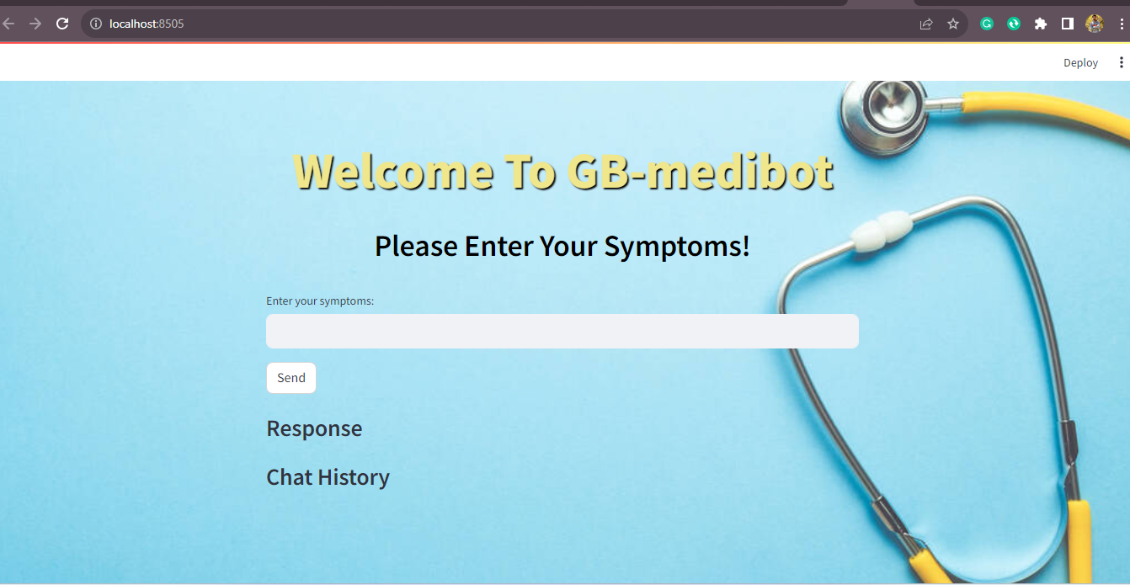

Slide 16


